Slide 1
MYLEGION: REPORTS
LGN and SAL Membership, Revitalization and Consolidated reports. Create a renewal letter and labels.
July 2024
MyLegion reports are for post, squadron, district and county groups only.
For department and detachment reports, contact your department adjutant.
Notes:
MyLegion provide membership reports, labels, and a renewal letter for administrators of posts, squadrons, districts and counties. For department and detachment reports, contact your department adjutant.

Slide 2
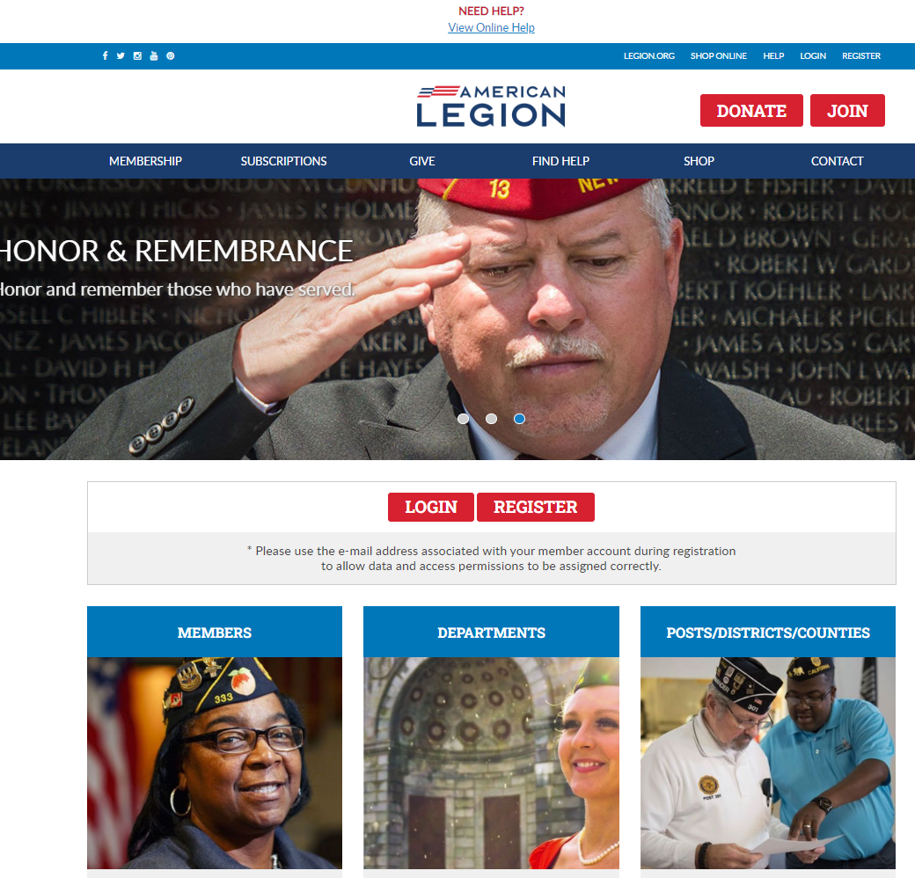
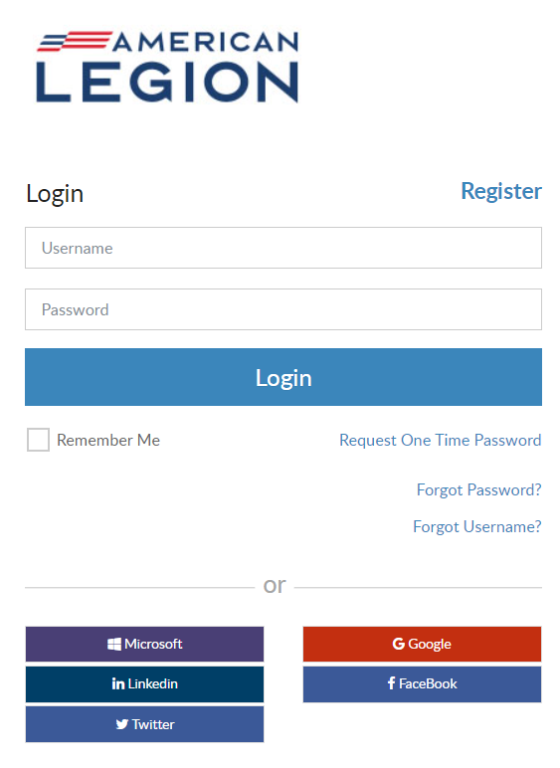
MYLEGION.ORG
Notes:
Log into MyLegion. All MyLegion accounts are registered to your individual member account using the primary email address on your record. Do not register a myLegion account with an email used by a group or another individual.

Slide 3
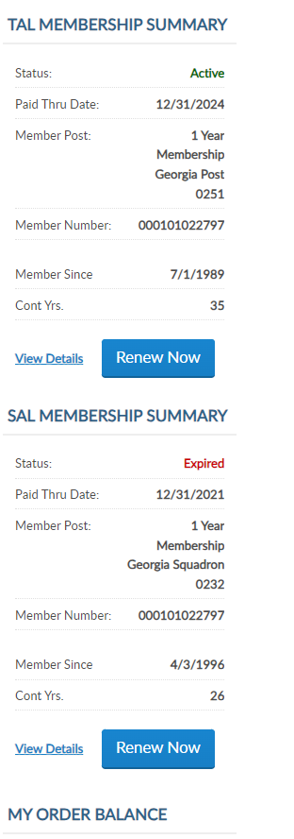
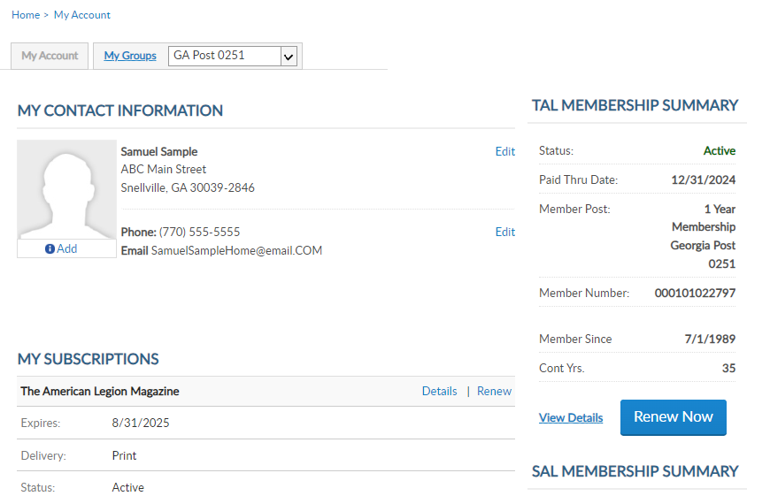
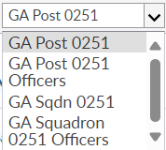
MYLEGION.ORG
My Account
Personal Member Info
My Groups
Adjutants & Commanders
Post, Squadron
District, County (View only)
Department, Detachment
Assigned Administrators
123456789
123456789
Notes:
When you log into MyLegion your My Account page displays information about your individual membership.
Adjutants and commanders of posts, squadrons, districts, counties, departments and detachments will have a My Groups menu when they are recorded in national’s membership system. The group menu is related to your position as an adjutant and commander. Members who have been assigned permission by one of the administrative officers will also have a My Groups menu. My groups is the administrative side of myLegion.
This member is a post adjutant and has 4 groups by default. <1> Legion leadership have access to both Legion and Sons of the American Legion groups. Officer groups are view only to see contact information for officers on file.
Clicking on the group will navigate you to the administrative side of MyLegion to access reports.

Slide 4
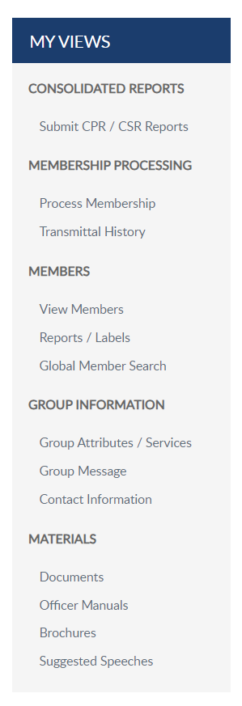
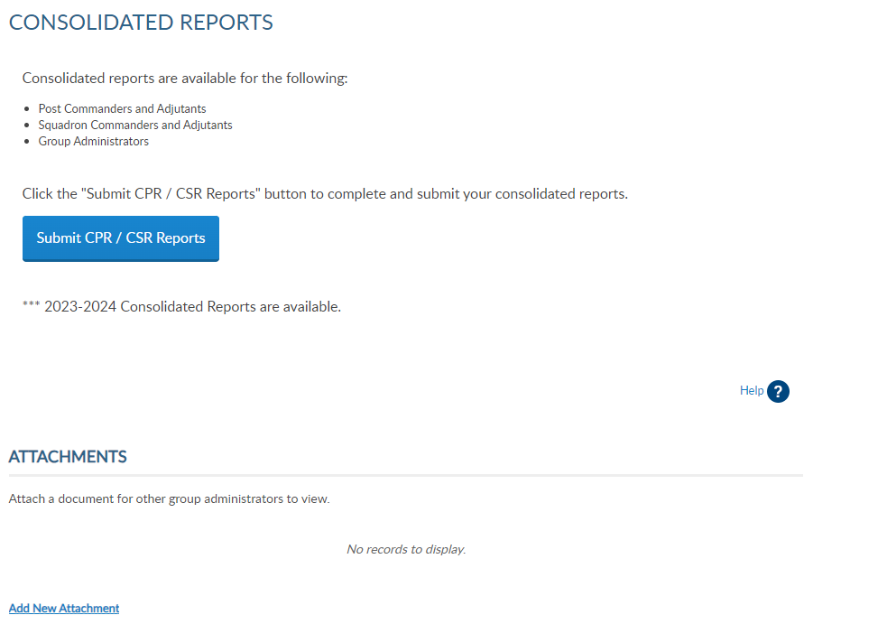
MY GROUPS: REPORTS
Consolidated Reports
Post (CSR)
Squadron (CSR)
Reports / Labels
Notes:
Reports available include Consolidated reports for posts and squadrons, membership reports, labels, and letters. Consolidated reports are not always available. After the deadline date, the report is closed, reviewed by national Internal Affairs division for revisions, and made available again for the next reporting year. During that time, you can still view previously submitted reports.

Slide 5
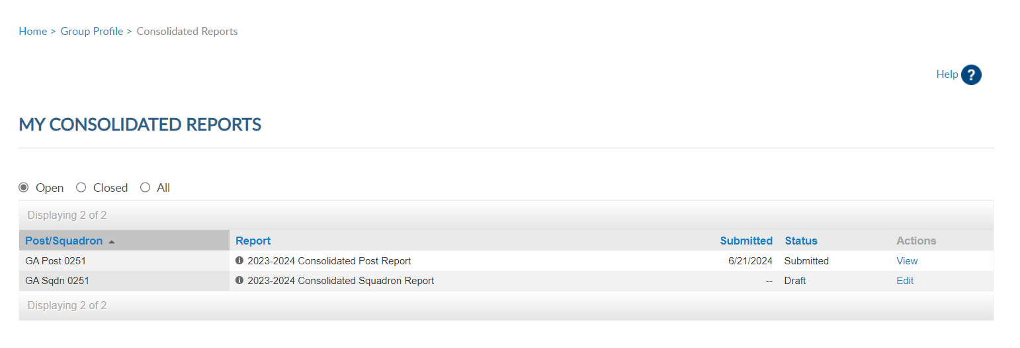
Open = Current Report
Notes:
There are 3 view areas in consolidated reports. Open includes current year reports.
Post adjutants have access to both reports. In this example the post report has been submitted. <1> You can click on View to open and print the report. Once submitted, you cannot make updates.

Slide 6
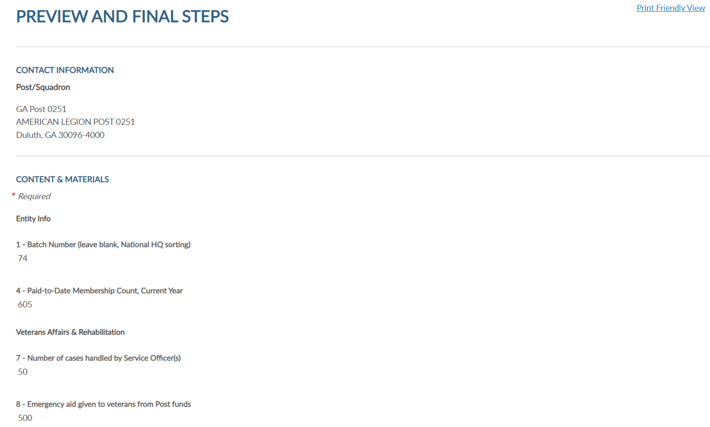
350
20
1500
Notes:
Click the link for printer friendly view to open the report in PDF to print. To return to consolidated reports click the breadcrumb link at the top of the page. <1>

Slide 7
Open = Current Report
Notes:
When the report is available for data entry, it will appear in draft status with Action set to Edit. The post report is submitted so let’s complete and submit the CSR. Begin by clicking Edit. <2

Slide 8
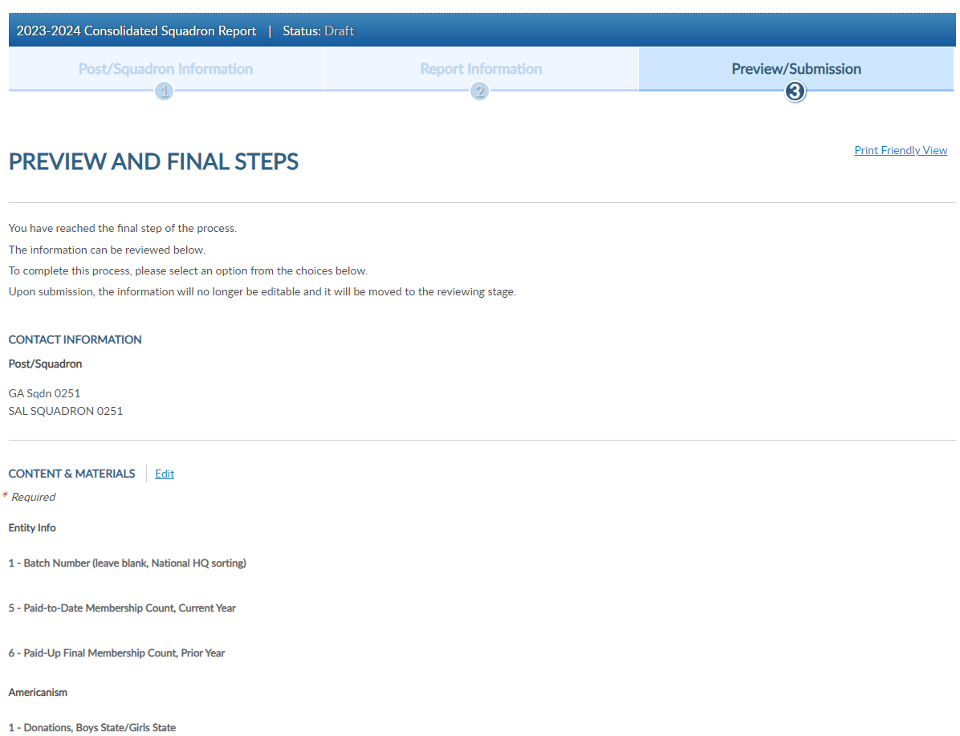
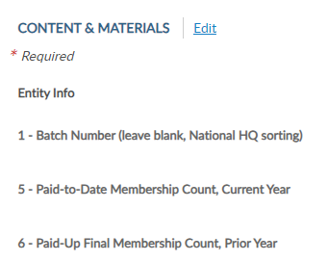
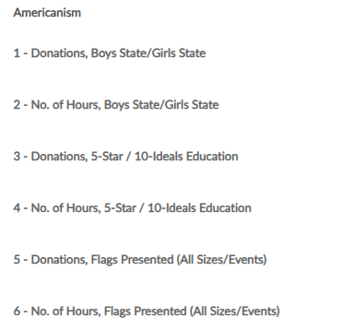
CONSOLIDATED REPORT
Edit to open fillable form.
Notes:
Click edit to open the fillable form. <1> Select Print Friendly View to Print the report at anytime. This allows you to print the report as a PDF document. Close the form to return to groups menu.

Slide 9
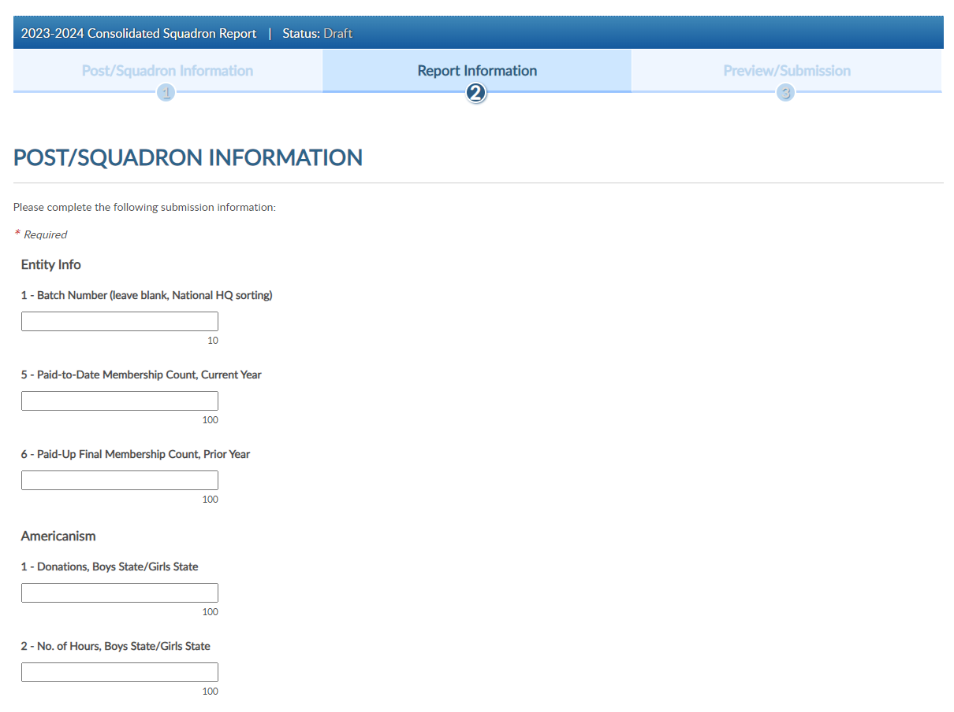
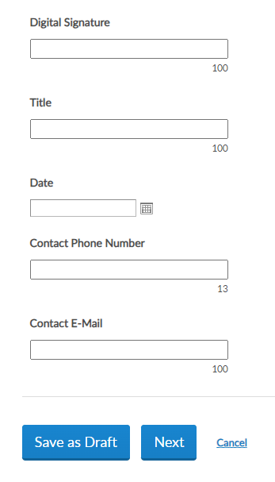
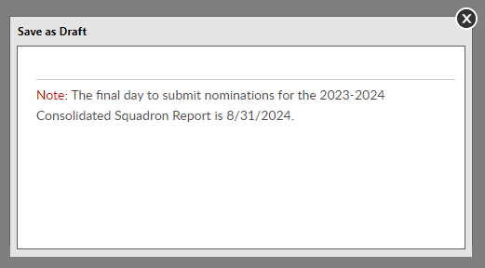
Notes:
Leave line one blank. This field is for national hq sorting. Enter data in the fields. The number of characters are identified by each box.
<1> continue through the form and at the bottom are options to save the form as a draft to continue later or click next to finalize.
<2> saving as a draft will display a message with the deadline date to submit online forms. After August 31, 2024 consolidated reports will be moved to closed status.

Slide 10
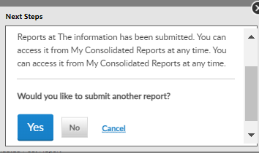
Notes:
To finalize the report, click Next <1> to view and select the Submit Final button. You will receive a notification the report is submitted.
Note, once the report is finalized it is saved as a submitted report. You will not be able to add data. If you plan to make additional updates, click Save as Draft and finalize by the due date.

Slide 11
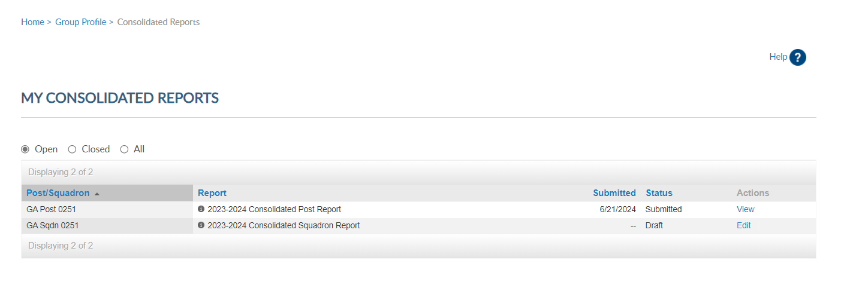
CONSOLIDATED REPORT
Open Reports: View status = form submitted.
Do not send paper report if submitted online. Dept. receives copy of reports.
7/19/2024 Submitted View
7/19/2024 Submitted View
Notes:
Submitted reports will remain in the Open area with a submitted status until the report is closed for the year.
If you submit online, you do not need to mail a paper form. The department has access to submitted report data.

Slide 12
CONSOLIDATED REPORT
Closed: Previous Years, View Only
Notes:
Closed include reports from the 2020-2021 reporting years are available. Notice closed reports in draft mode only have view in actions. Reports were not submitted for that year.

Slide 13
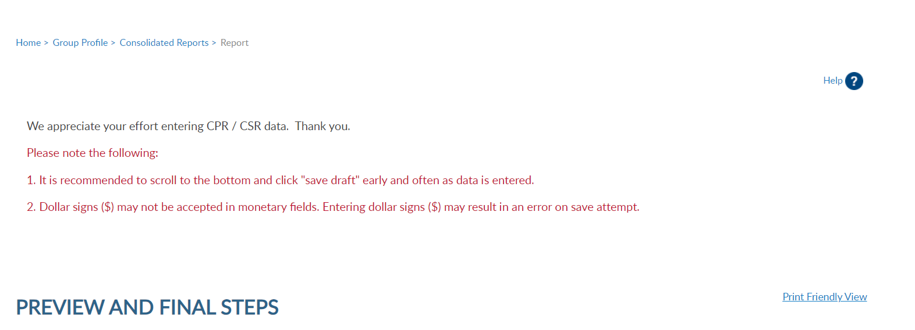
GROUP PROFILE
Click “Group Profile” to return to MyGroups home page.
Notes:
Click on Group Profile to return to group administrative window and access other reports.

Slide 14
REPORTS / LABELS
Membership Rosters
Mailing Labels
HQ Member Lists
Renewal Letters/Labels
Notes:
Membership listings, roster updates, members renewed online, HQ member listings, mailing labels and a renewal letter are available through Reports/Labels.

Slide 15
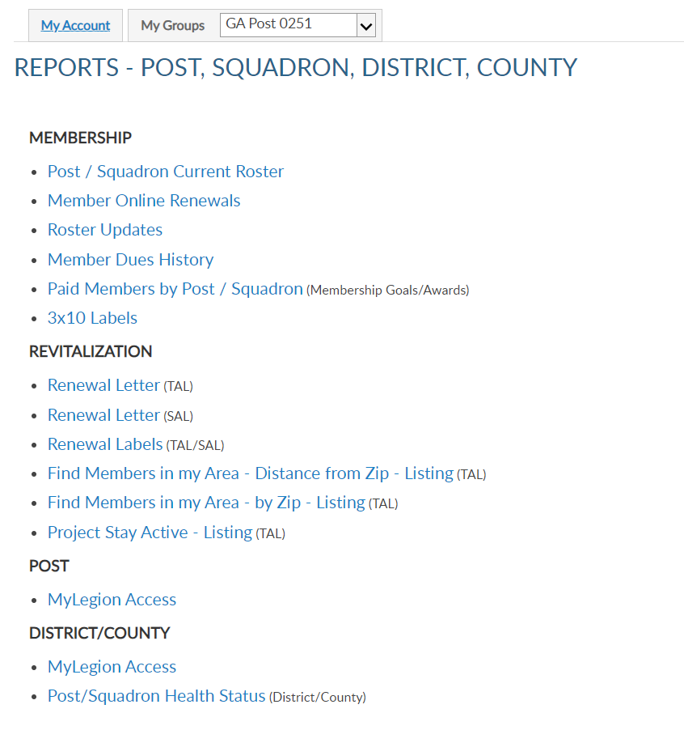
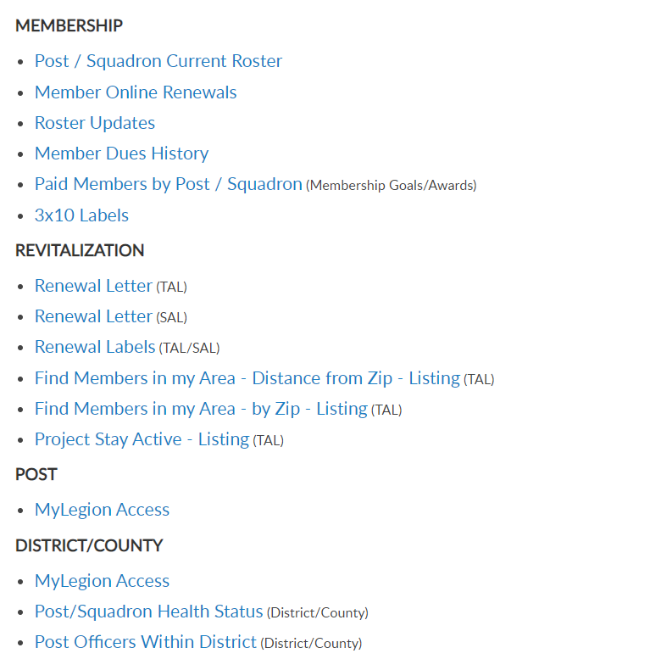
POST / SQDN CURRENT ROSTER
Current Members
Active, Deceased, Expired
Members transferred out are not included Current Roster.
Notes:
Reports include post and squadron membership assigned to your group. To generate reports, you will first select the report and then the group and criteria. Let’s begin with a current roster report. This report includes current members of the post or squadron. Members who have transferred out, are not included in current membership. To view members who have paid to your post or squadron, generate a Paid Members report.
Click on the report name to proceed.

Slide 16
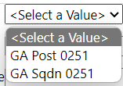
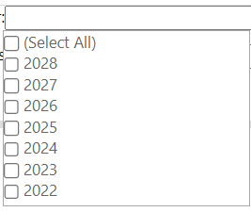
CURRENT ROSTER
Report Data Filters
Group – districts and counties will have all post/sqdns in their area.
Last Paid Year
Expired: 2022, 2023
Current: ≥ 2024
Paid Up For Life: 2025, 2026
Multi-Year Renewals: ≥ 2026
PUFL membership is rolled over on July 1 for the new campaign year and display LPY 2025.
LGN members paid for 2025 that purchase PUFL have LPY 2026.
Notes:
All reports are created using data filters. Filtering menus allow flexibility to the data included in the roster. The first field selected is Group. <1> Using the pulldown menu select the post or squadron to generate a report. District and county access will display a menu with all posts or squadrons in the area.
Next select last paid year. <2> Last paid year on a member’s record allows you to identify expired, current and future paid members.
<3> Legion members who are currently paid that purchase a Paid up For Life membership will also display a last paid year of which PUFL allotment will be due the post.
<4> American .Legion members who purchase a multi-year renewal will display the membership year they are paid through.

Slide 17
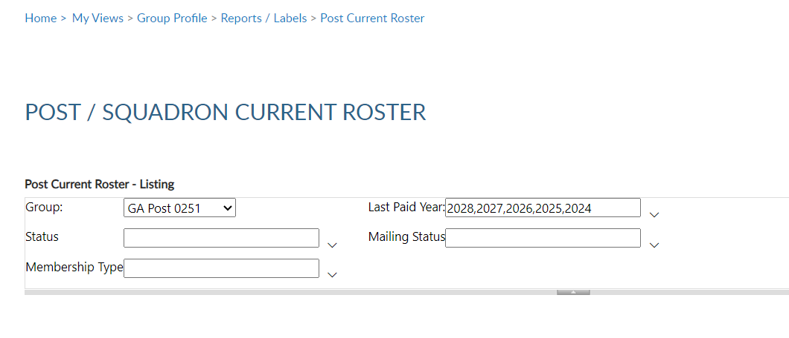
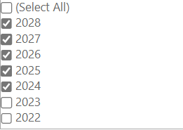
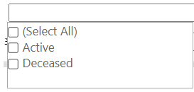
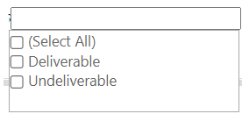
CURRENT ROSTER
Report Data Filters
LPY – Current
Status
Mailing Status
Notes:
In this example, the 2024 and all years greater are checked to capture all PUFL and multi-year paid members.
<1> Status includes active and deceased. Deceased members will remain on the roster and can be filtered out by selecting active only.
<2> The next filter is mailing status. Mail status let’s you know if the mailing address on file is good or flagged as undeliverable. Members with undeliverable status do not receive The American Legion Magazine, renewal notices, or any mailings from National Headquarters. Contact those members, if possible, to collect a valid mailing address and update. Updating an address that marked as undeliverable will remove the flag. If a member states the address on file is good, contact National Customer Service to remove the flag.

Slide 18
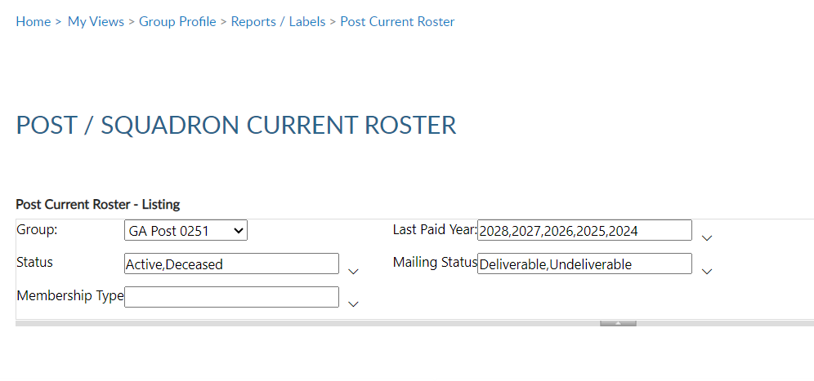
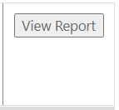
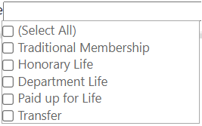
CURRENT ROSTER
Report Data Filters
Membership Type
View Report
Notes:
Membership type includes traditional 1-year renewal, honorary life, department life, paid up for life and if the member is a current transfer.
After all data fields have been set, click View Report.

Slide 19
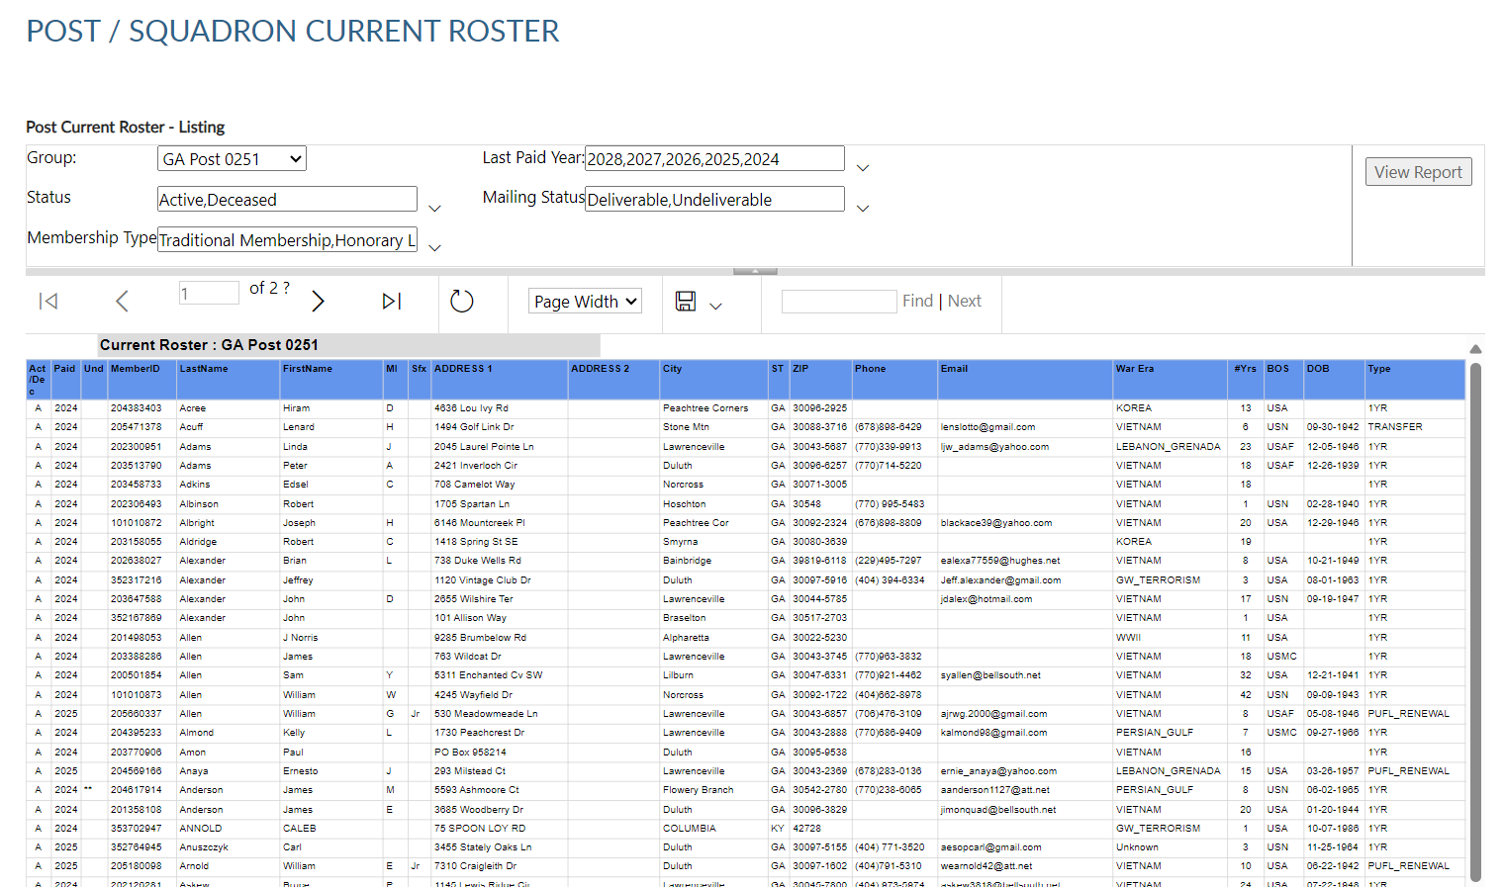
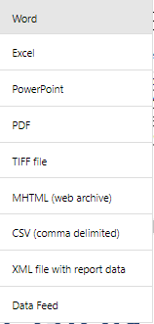
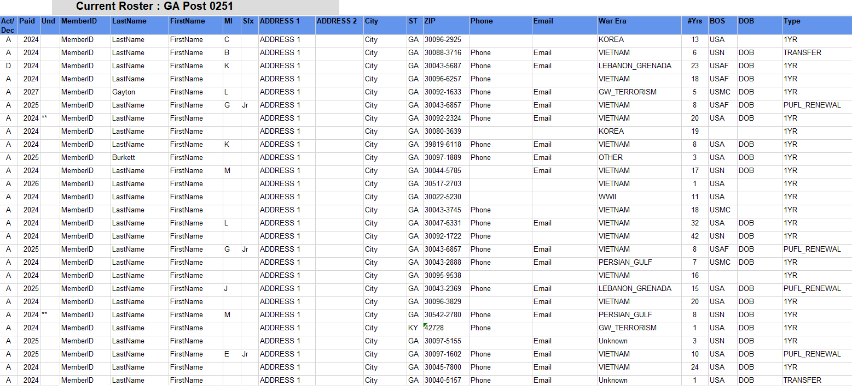
Navigation
Export
REPORT PROPERTIES
Notes:
The report generates. All reports provide navigation tools to allow you to go from page to page <1> , and to the first and last page. <2> There is a search filter to find specific data in the list. <3> Using the export Icon, export to an Excel document.

Slide 20
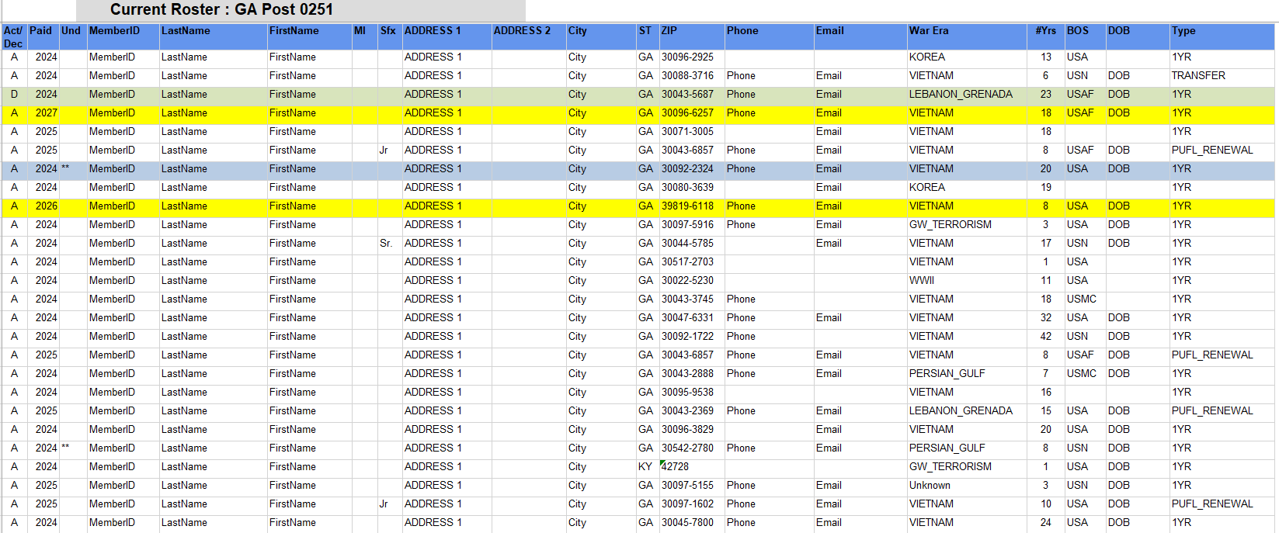
POST CURRENT ROSTER
Notes:
The roster includes status, paid year, contact information, conflict, continuous years, branch of service, date of birth and membership type. It also includes the total count at the bottom.
Members with asterisk have been flagged with an undeliverable address. <1> They will not receive renewal notices, subscriptions, or publications if they have an undeliverable address.

Slide 21
PAID MEMBER BY POST/SQDN
Department Goals/Awards
Paid / Mbrship Year
Includes paid members who have transferred out.
Notes:
The Paid Members report is the report corresponding with Department membership reports. It includes all members paid for the current year, even if they transferred out.
.

Slide 22
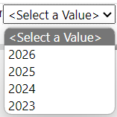
PAID MEMBER BY POST/SQDN
Data Filters
Organization
Post/Squadron
Last Paid Year
A member that joins through the national DMS program is placed into a HQs post and dues are encumbered (AD) to national HQ until the member renews twice or is transferred to a local post.
Notes:
This report includes encumbered and unencumbered HQ transfer members. Check with your department to se what counts toward annual membership goals. A member that joins through the national DMS program is placed into a HQs post and dues are encumbered (AD) to national HQ until the member renews twice or is transferred to a local post.
Report filters begin with organization, The American Legion or Sons of the American Legion. group, and last paid year. This report may be slow to load.

Slide 23
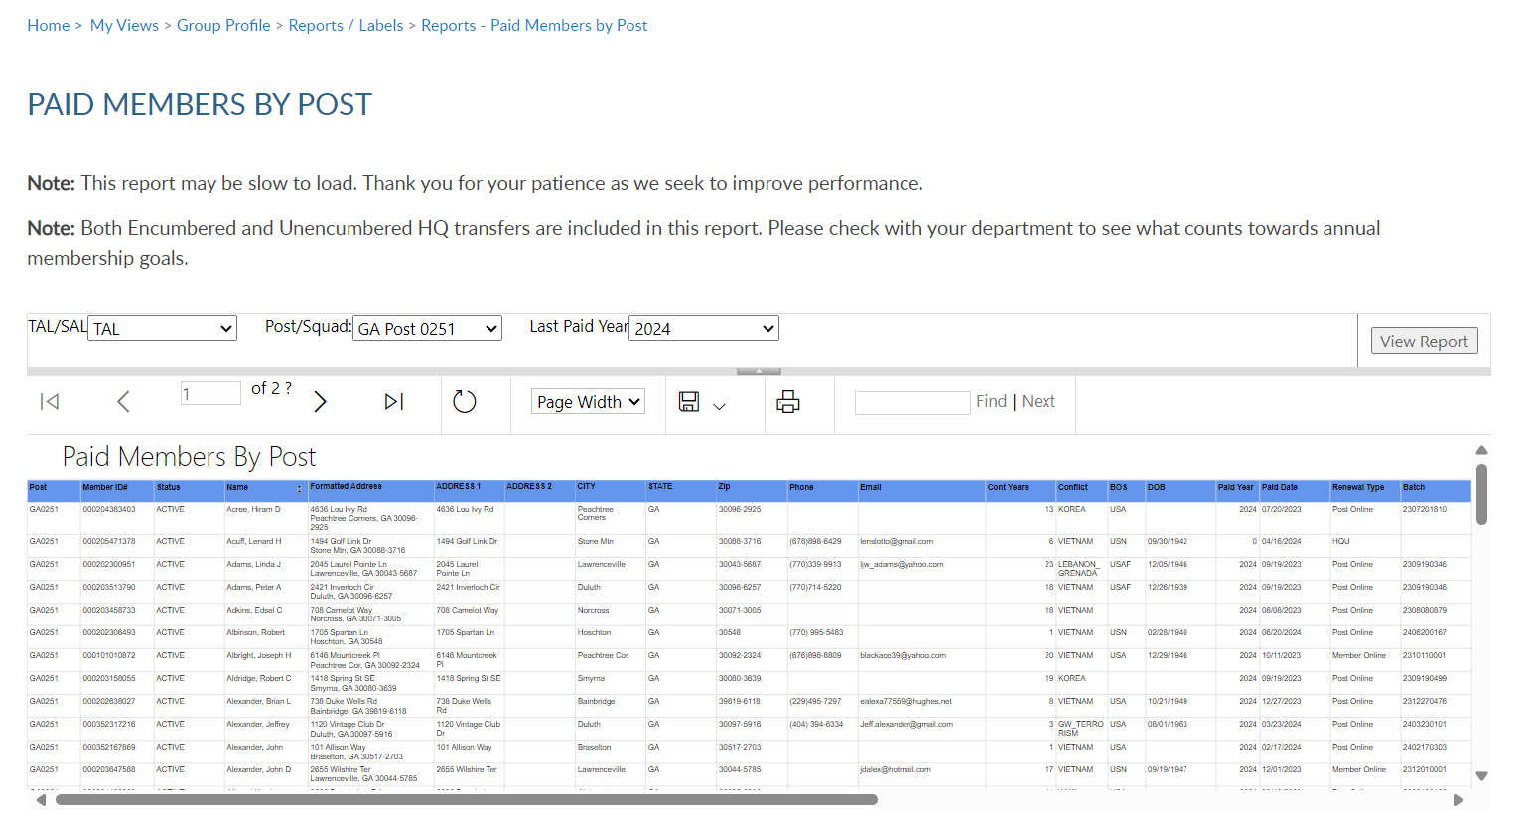
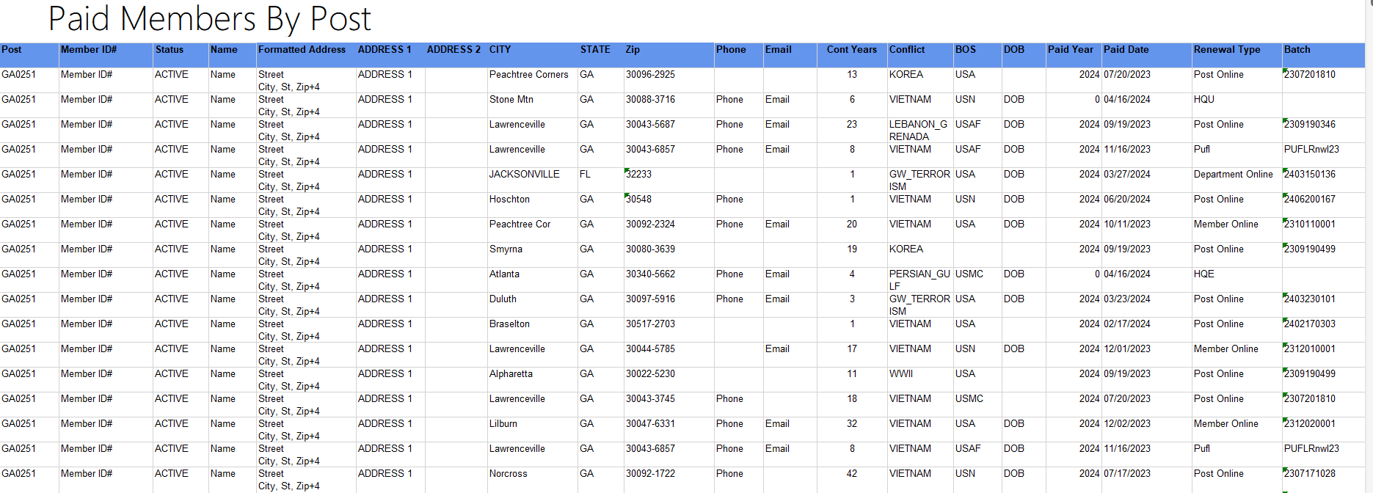
PAID MEMBER BY POST/SQDN
2024 Paid Members
Export:
PDF
Excel
Notes:
In this example we will pull a 2024 paid members report. Export the report to Excel. <1>

Slide 24
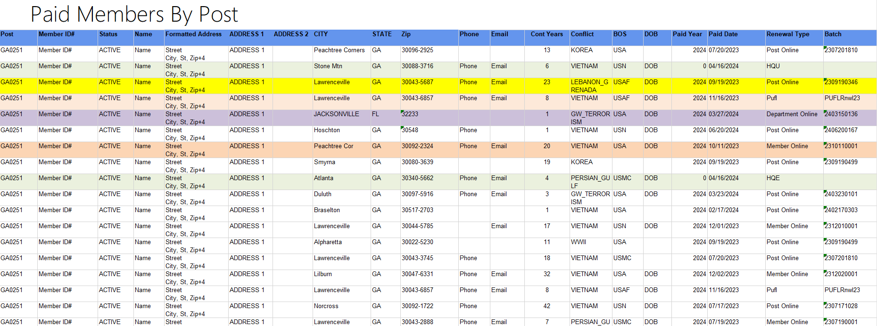
PAID MEMBER BY POST
Current Roster
Notes:
This report provides members paid to the post, even if transferred out. It also identifies the renewal type and batch number. The paid members report will correlate with department membership goals reports.
<1> The report may differ from your roster total. Use the roster update report to view members who have transferred out of the post.

Slide 25
MEMBER ONLINE RENEWALS
Payment collected by National HQs.
Post dues are sent to department to distribute.
Dues must equal National + Department per capita for a member to renew online.
Notes:
Legion members that renew online can be identified using the Member Online Renewals Report.
Online renewal is available for Legion and Sons of the American Legion membership. When a member renews online, National collects dues on file for the post. Post and department allocations are sent to the department to distribute.
If the post dues do not cover the minimum of national plus department, online renewal will not be available and result in an error message if the member attempts online renewal.
Click on the blue hyperlink to begin the members online renewal report.

Slide 26
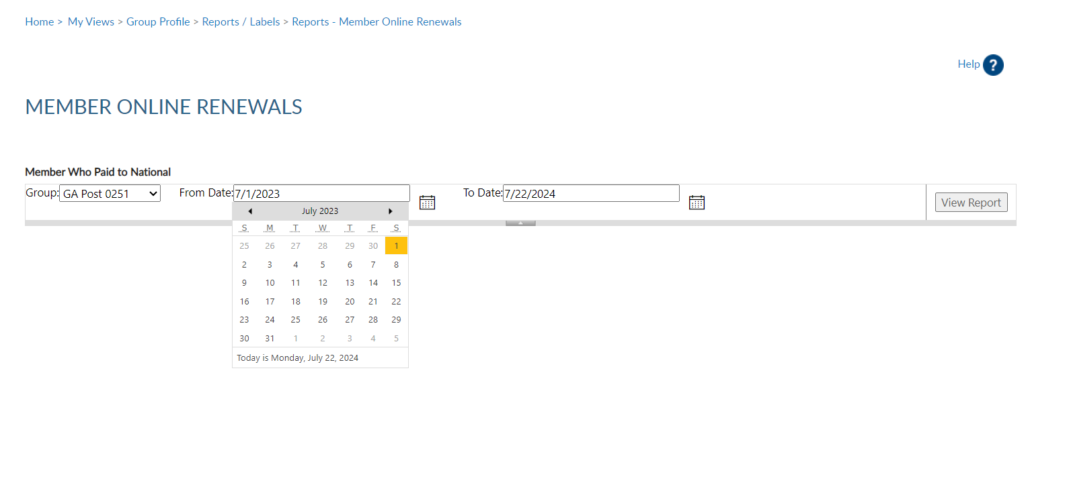
Lists member paid online through national headquarters.
MEMBER ONLINE RENEWAL
Notes:
Group selection is required. Date range selection is updated by clicking on the calendar icon. Use the left and right arrows to navigate by month and year. Click on the date in the calendar to set. <2> Click View Report to generate listing.

Slide 27
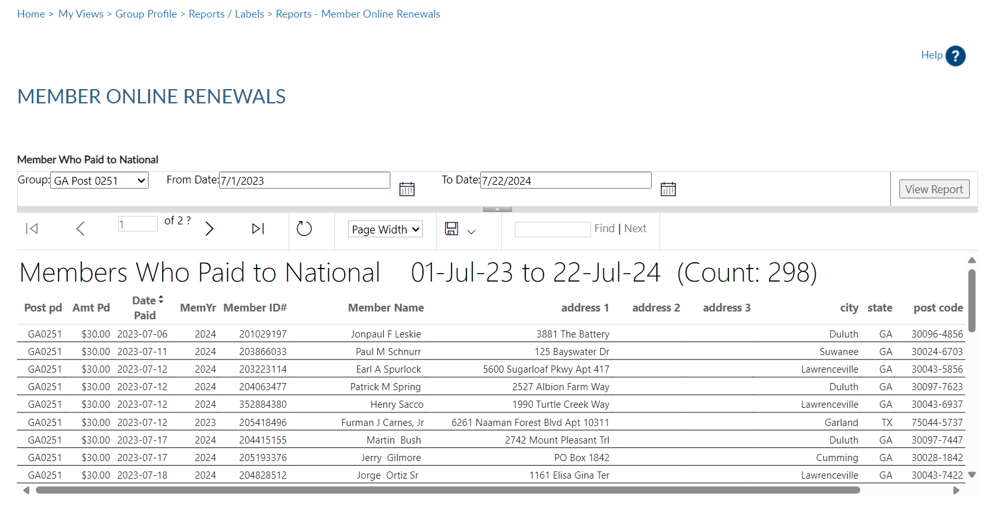
Lists member paid online through national headquarters.
MEMBER ONLINE RENEWAL
Notes:
The export icon print and save reports. Reports are not saved within the report writer.

Slide 28
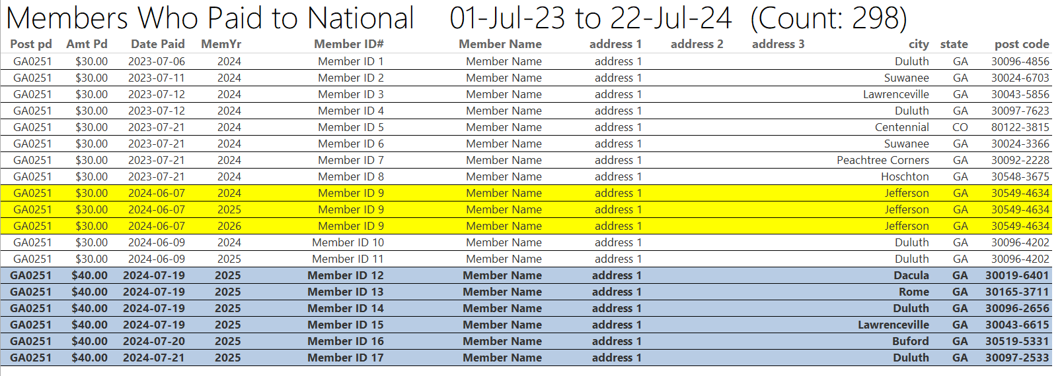
Lists member paid online through national headquarters.
MEMBER ONLINE RENEWAL
Notes:
This report provides the total count with names, member id#, date and renewal year. The amount paid displays the total amount of dues collected by the member, as reported on the annual post data report. Beginning July 1, 2024 the post dues were raised to $40.
Members who renew for multiple years display. Dues allocations are sent to departments on the July membership statement sent by national finance division.

Slide 29
ROSTER UPDATES
Data Updates:
Address Updates
Deceased
Transfer in/out
New Join
Notes:
The next report is Roster Updates. This report identify updates on a member record. Data updates can be made my members, local and department leadership, and by national customer service requests. View address updates, deceased notifications, members who have transferred in and out ,and new joins.

Slide 30
Updates to member information for address, deceased status, transfer information and new members (new join).
ROSTER UPDATES
Notes:
Select your group first. Using date range and update type you can produce various results. Want to see who transferred out this membership year, select transfer out only. You can pull a list of all members marked as deceased, identify new joins, and address updates.
After all filters are set View Report to generate. <1>

Slide 31
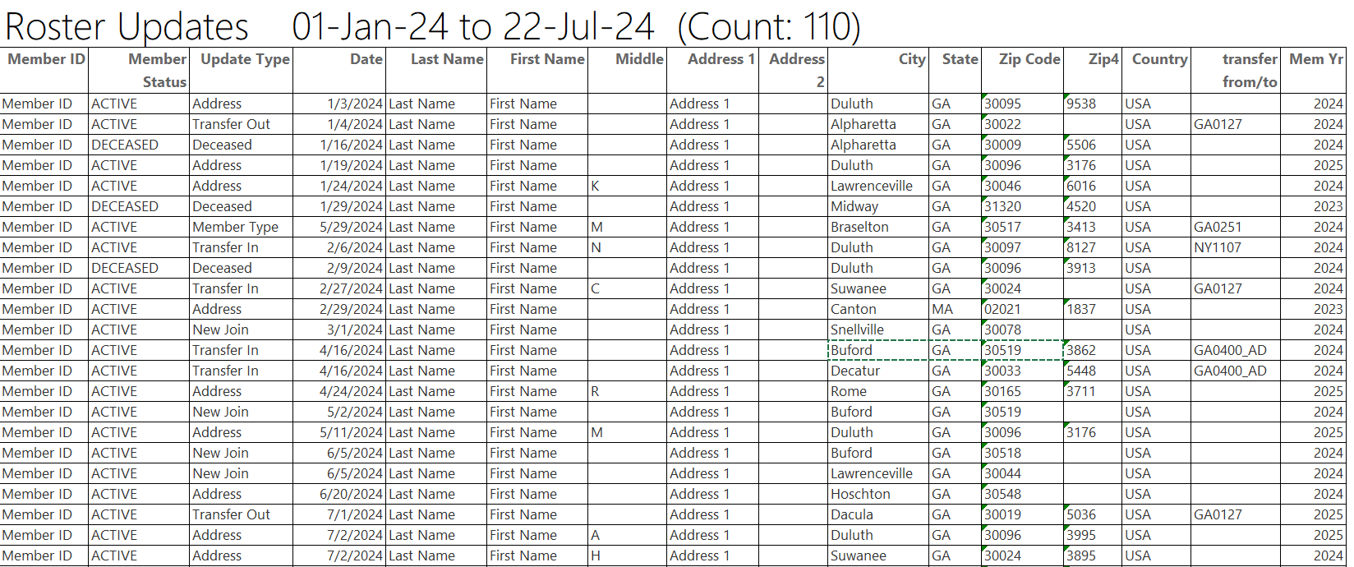
Notes:
The report gives you information on updates made to the member record. Notice transfer information includes to and from information. Members who transfer out of your post no longer appear in current roster or current membership reports. Paid members who transfer out will be included in the Paid Members report.

Slide 32
MEMBER DUES HISTORY
2011 to current paid dues.
Notes:
Dues history report displays payment information from 2011 to present.

Slide 33
MEMBER DUES HISTORY
Displays member payments from 2011 to current.
Notes:
Enter the 9-digit membership number and organization and click View Report.

Slide 34
MEMBER DUES HISTORY
Displays member payments from 2011 to current.
Notes:
Payment history includes 2011 to present. If more payment information is needed, contact your department headquarters. Departments can work with national headquarters to view archived data.

Slide 35
3 X 10 LABELS
Standard 30/sheet labels.
Notes:
3x10 labels produce a 30 per sheet label that fits Avery 5160 or any 30/sheet blank labels.

Slide 36
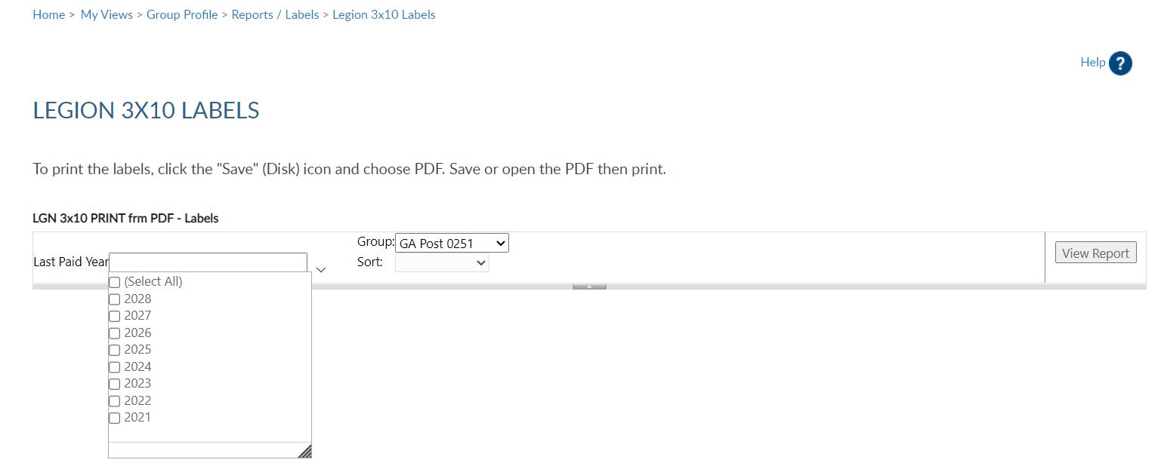
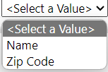
LABELS
30 per sheet mailing labels for LGN and SAL members.
Notes:
Filtering options allows you to define the members included in labels. Deceased and members flagged as undeliverable will be suppressed from mailing labels.
The first step is to select the group. Next, select the last paid year or multiple years. <3> Designate if you want your labels sorted by last name or zip code.
After parameters are set, View Report to continue. <1>

Slide 37
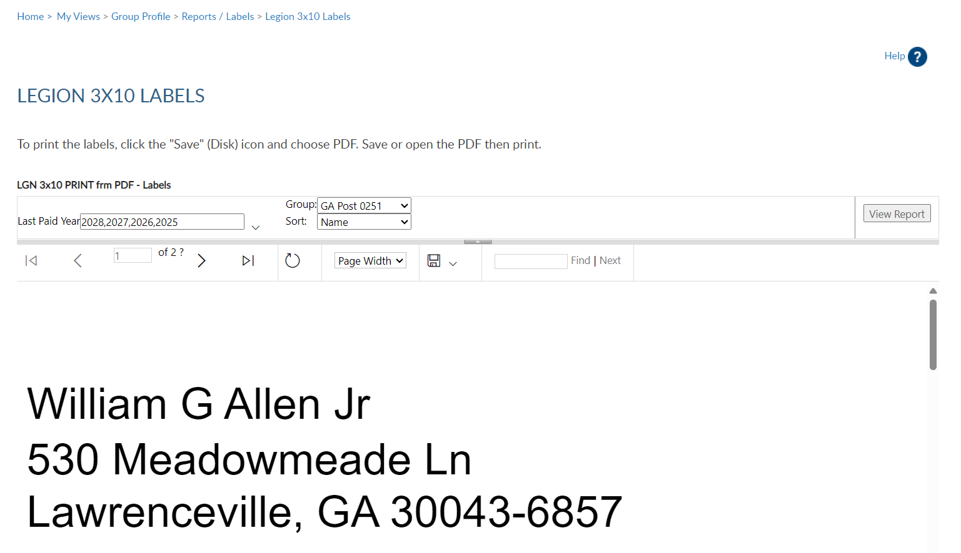
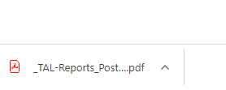
LABELS
30 per sheet mailing labels for LGN and SAL members.
John Adams
123 Main Stret
Lawrenceville, GA 30043-6857
Notes:
The label display is not in 30/sheet format. Send the data to a PDF document selecting the export icon. <1> The export icon is used print and save all reports using the file types in the menu. PDF is the only selection that applies for labels. After you select PDF look for a tab to open the PDF generally located at the lower left of your window.

Slide 38
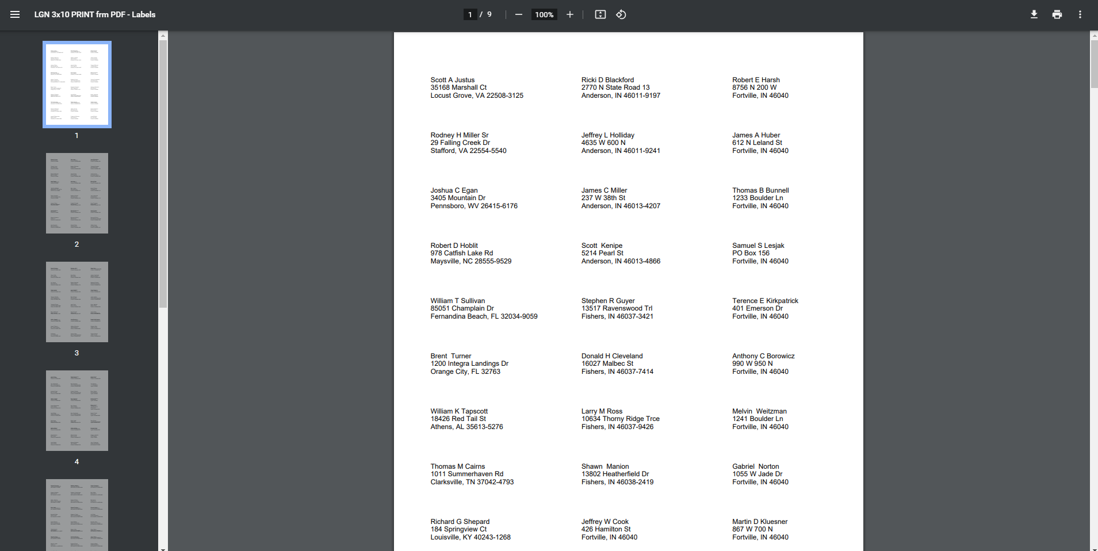
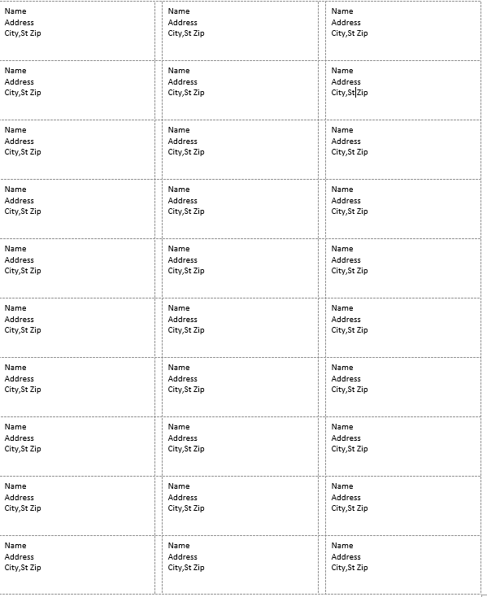
Notes:
The PDF opens to print labels. <1> Use the print icon to send to your printer.

Slide 39
RENEWAL LETTERS
Invite expired members to renew to your post or squadron with a personalized letter.
Print mailing labels to go with letters.
Notes:
A renewal letter and labels are available to reach out to expired members. <1> You can also generate mailing labels to go with the letter using the same filters.

Slide 40
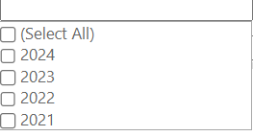
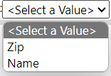
RENEWAL LETTERS
Pre-written custom letter inviting expired members to renew. Create labels for your letter using the same filter criteria.
Notes:
Creating the letter begins with filters. Select the group first. This populates the contact name and title with commander information. <1> These fields can be modified by typing new text in the fields.
<2> Enter last paid year or multiple years, and sort option. Only expired years will be available. Click <3> View Report to generate.

Slide 41
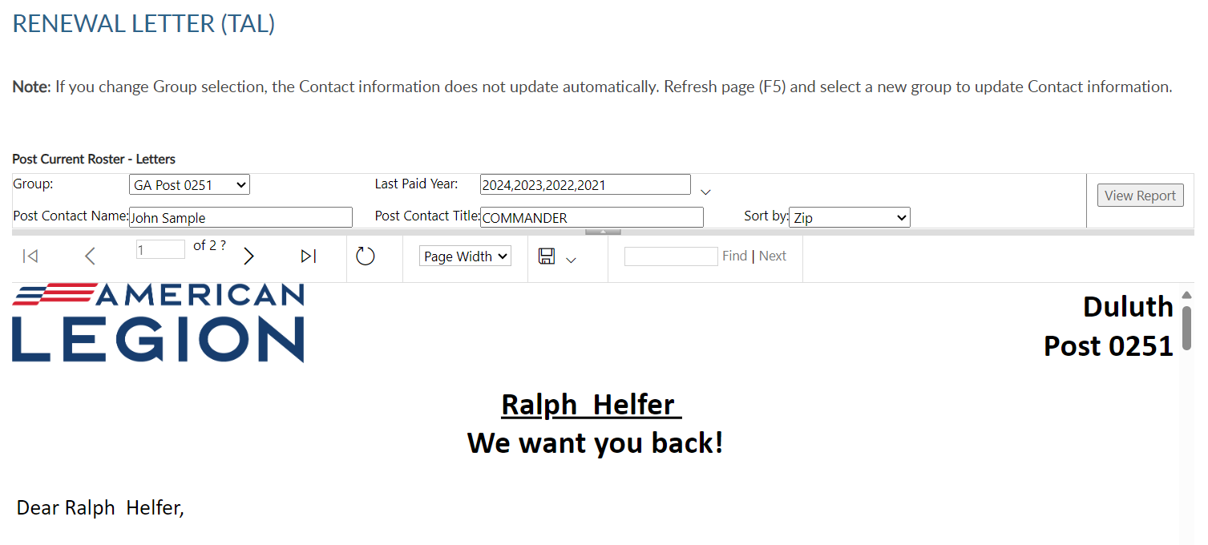
Notes:
The personalized letter generates. Letters need to be exported to print. Using the export icon, export to a PDF <1>.

Slide 42
Personalized Letter
Member
Post
Remittance Slip
RENEWAL LETTERS
Notes:
The letter is personalized using member and post or squadron information including dues and dues remittance address. <1> The bottom of the letter includes a remittance slip with dues amount and member information. The member’s address is located so that you can use a window envelope.
If there is missing contact information, a line is provided for the member to complete and return with dues.

Slide 43
HQ MEMBERS
Find Members in My Area
Distance from Zip (one zip code can be selected)
By Zip (select multiple zip codes)
Notes:
To create a listing of HQs post members, begin in Reports and Labels – Find Members in My Area.
Find Members in my Area provides contact information for Legion members in your state headquarters post within a designated area defined by zip code. Click the Find Members in my Area blue hyperlink to set parameters and create report.

Slide 44
FIND MEMBERS IN MY AREA
Distance From Zip: Locate headquarters post members using distance, 1 zip code and last paid year search.
Notes:
When using this report, enter last paid year, distance, and zip code. Only one zip code can be selected when using find members in my area by distance. All zips are within your state. This report is not to be used to locate members in other departments. Click ”View Report” to generate.

Slide 45
30002
Notes:
The report includes contact information to reach out and invite them to transfer to your local post. Post numbers that include AD <1> are encumbered members. Encumbered only relates to HQ Post members. HQ post member’s join through the national DMS program and are placed into a HQs post. Dues are encumbered to national HQ until the member renews twice or is transferred to a local post.

Slide 46
FIND MEMBERS IN MY AREA
By Zip Listing: Locate headquarters post members using multiple zip codes and last paid year search.
Notes:
The other Find Members in my Area Report by Zip listing allows entry of multiple zip codes within your state and last paid years.

Slide 47
PROJECT STAY ACTIVE
Find members who have moved to the area within the last 45 days.
Members with address updates in the area selected.
Notes:
Locate members who have moved into your area within the last 45 days using the Project Stay Active listing.

Slide 48
Locate members who have moved into your area within the last 45 days.
PROJECT STAY ACTIVE
Notes:
Choose zip code and distance and View Report. <1>

Slide 49
Notes:
The listing provides contact information to welcome the member to the community, introduce them to your post or squadron and invite them to transfer. As with all other report, export to save or print.

Slide 50
MYLEGION ACCESS
Monitor who has access to MyLegion for your group.
Notes:
Monitor who has access to your group in MyLegion using the MyLegion Access report.

Slide 51
MYLEGION ACCESS
Post /Squadron
District/County
Notes:
The group menu displays who you have access to maintain. District and county administrators will have a listing of all posts or squadrons in your group. . <1> Click View Report to see the list. <2>

Slide 52
Notes:
Adjutants and Commanders will have access by default and have access to manage permissions. To update permissions, search the member record and go to Assign Group Permissions.

Slide 53
POST/SQDN HEALTH STATUS
District and counties can view member processing activity, consolidated reporting status and address status.
Notes:
Post/Squadron Health Status, is for district and county officers. District and counties can view member processing activity, consolidated reporting status and address status.

Slide 54
POST HEALTH STATUS
Monitor post and squadron membership processing and consolidated reporting.
Notes:
Group selection will include district and county groups. Enter your group, last paid year and <1> View Report.

Slide 55
Notes:
The list provides post or squadrons with their last transmittal date, number of unpaid members, consolidated report status, and address information.
To return to MyLegion home or group profile window, use the breadcrumb links at the top of the page. <1>

Slide 56
POST OFFICERS WITHIN DISTRICTS
District and counties can view post officers.

Slide 57
POST OFFICERS WITHIN DISTRICT
District permission allows you to create a report identifying officers of the posts in your district or county.
Notes:
District permission allows you to create a report identifying officers of the posts in your district or county. Select your district group, and <1> View Report.

Slide 58
Notes:
The list includes all post officers recorded in national’s database with contact information. Officer information is reported through your department headquarters.

Slide 59
MY ACCOUNT & HELP RESOURCES
Notes:
Learn more about MyLegion using “Find Help” and go to How to use MyLegion.org.

Slide 60
Online Help
Notes:
Step by step instructions, videos and training presentations will assist with how to manage your member account and groups in MyLegion.

Slide 61
Contact your department or national MyLegion support to assist with any questions or help with MyLegion.
MyLegion@legion.org
833.253.9995
Monday – Friday
8:00am – 4:30pm
(Eastern)
Notes:
Contact your department or national MyLegion support to assist with any questions help with MyLegion.

